Slide 1

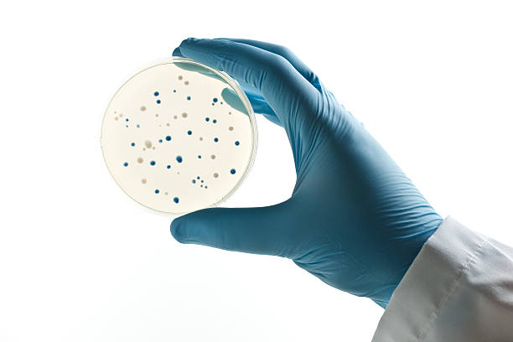
AgarVision
Authors
Ibraheem Ganayim SWE Department
Simaan Saada SWE Department
Supervisor
Dr. Reuven Cohen SWE Department
Co-Supervisor
Dr. Lilach Iasur Kruh BTE Department
Capstone Project Phase B
23-2-D-20
ML-powered app to detect, analyze and count agar plate bacteria colonies.

Slide 2
Outline
Background ---------------------------------------- 3
Problem ---------------------------------------------- 8
Solution ---------------------------------------------- 10
System Architecture ------------------------- 23
Challenges & Limitations ----------------- 26
Results ------------------------------------------------ 31
Verification ---------------------------------------- 37
Conclusion ----------------------------------------- 43

Slide 3
Background

Slide 4
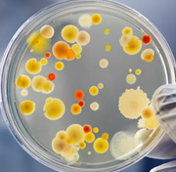

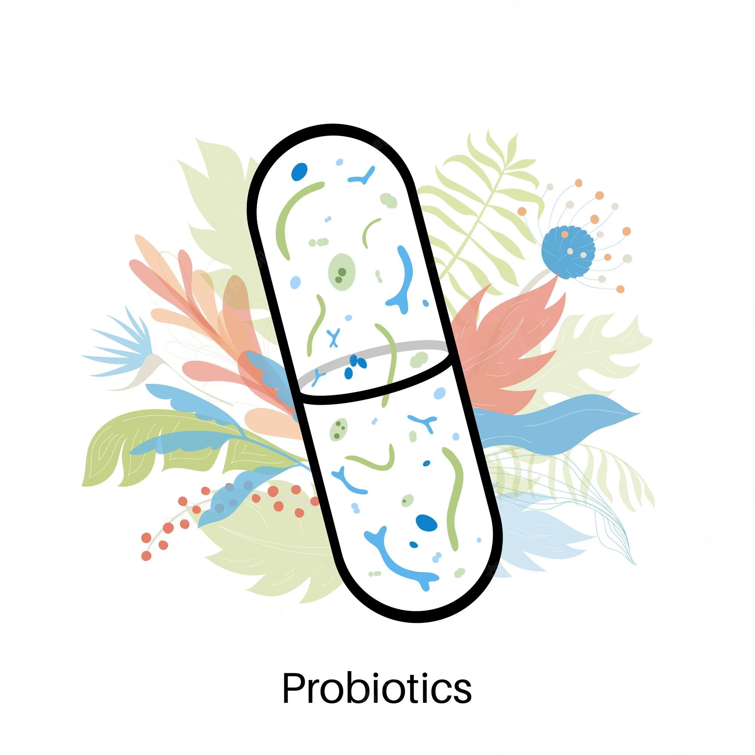
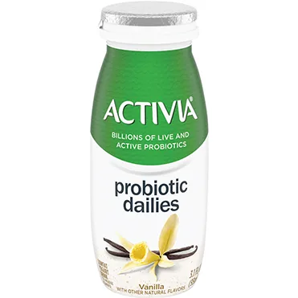

Probiotics
3
2
4
1
5

Slide 5
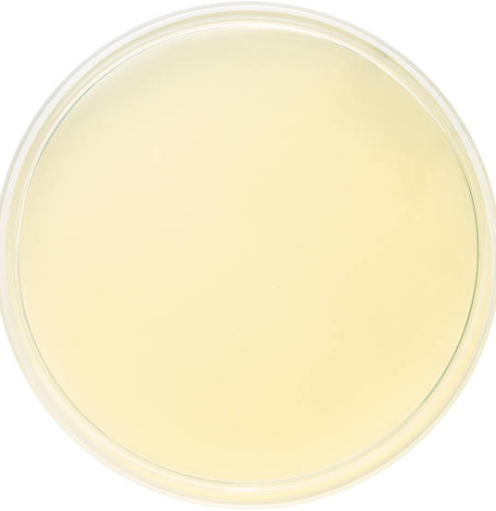
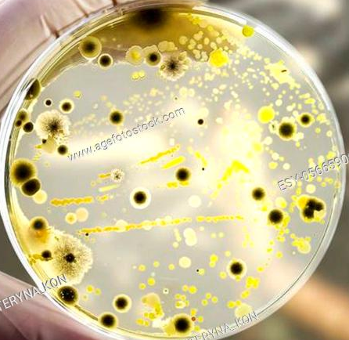
Biotech Labs
Track the growth of bacteria colonies on agar plates.

Slide 6

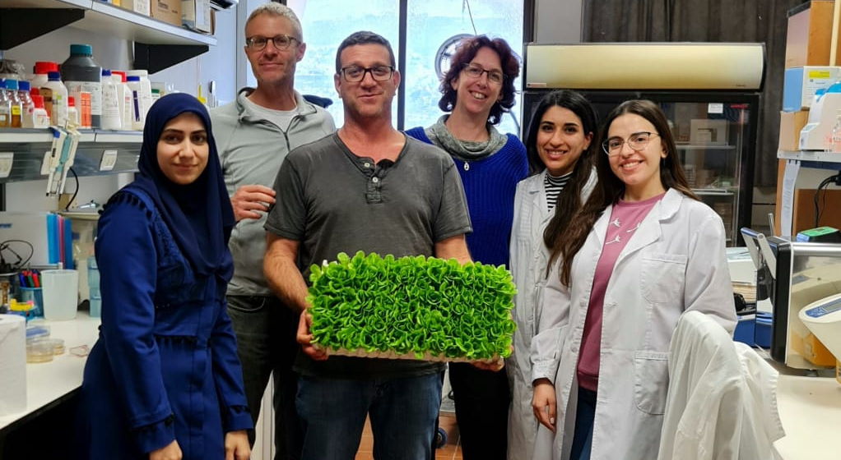
The Wonder Veggies Team

Slide 7
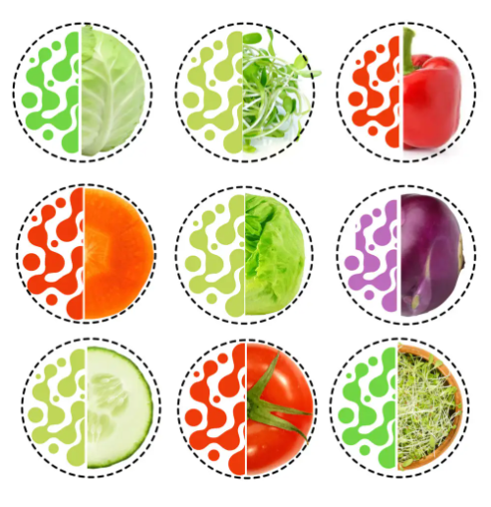
Wonder Veggies _{LTD}
Mission
Revolutionize the vegetable market by marrying the benefits of fresh vegetables with healthy probiotics.
Dr. Lilach Iasur-Kruh
Co-Founder & Director of Technology

Slide 8
Problem

Slide 9
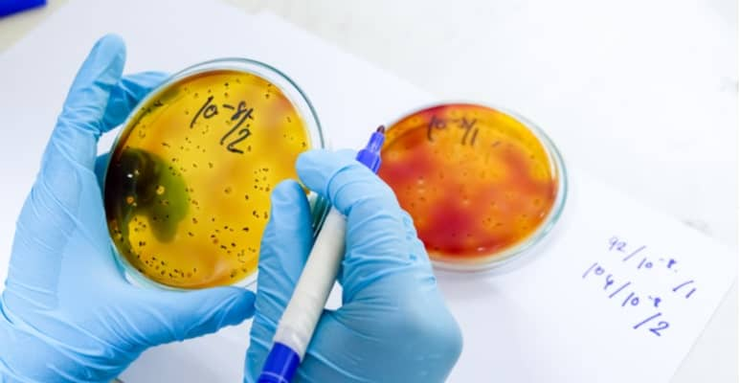
Manual counting of bacteria colonies
Time excessive
Prone to error
No collaboration
Data may be lost
Expensive alternatives

Slide 10
Solution

Slide 11

System Requirements
User-Friendly Interface.
Accurate & Fast Colony Counting.
Collaborative.
Store Data Securely & Reliably.

Slide 12

AgarVision
ML-powered app to detect, analyze and count agar plate bacteria colonies.

Slide 13
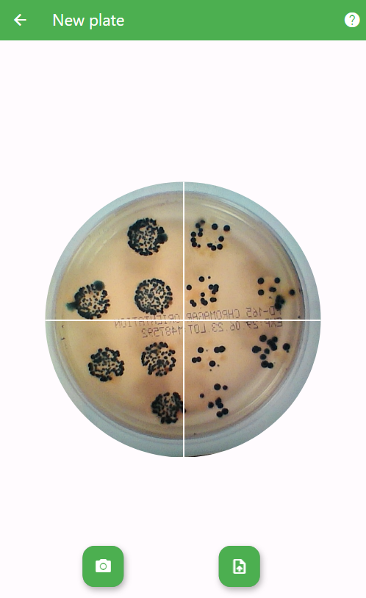
Capture Plate
Take/Upload a picture of an Agar plate with bacteria colonies.

Slide 14
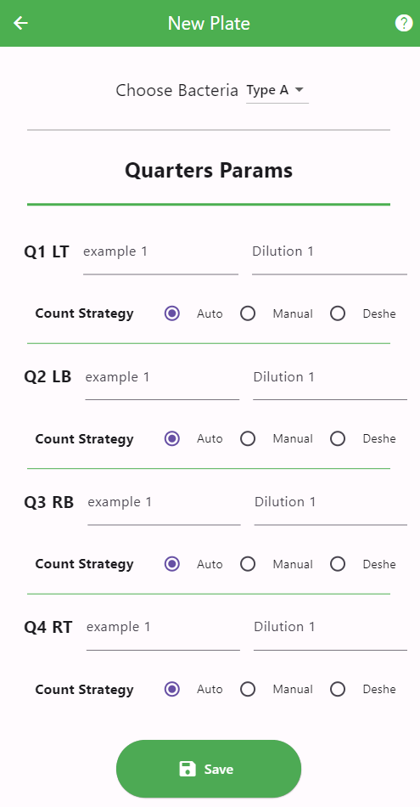
Setting Experiment Parameters
For each quarter
Type ex. Bacteria A
Example ex. 3
Dilution ex. 0.29
Count Strategy ex. Auto
Notes:
Explain about every parameter in this page. Bacteria type, dilution,colors.

Slide 15
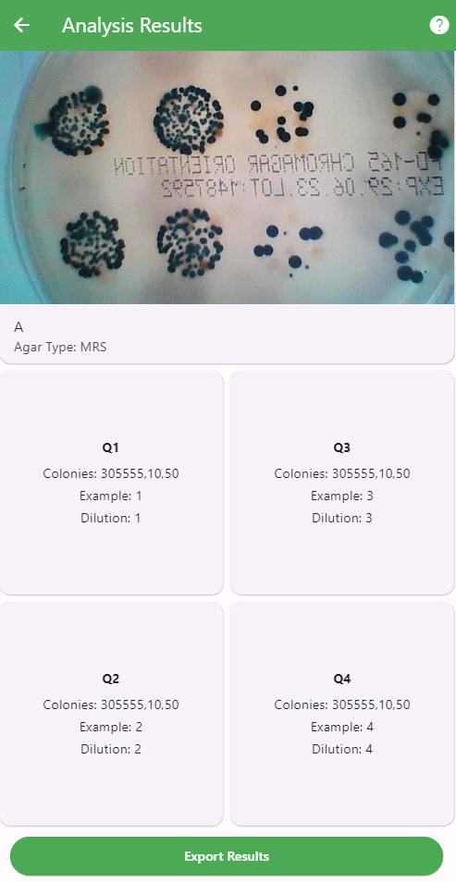
Experiment Details
For each quarter
Review experiments results in detail.
No. of colonies
Example
Dilution
Notes:
Explain what is dilution and CFU, and colonies.

Slide 16
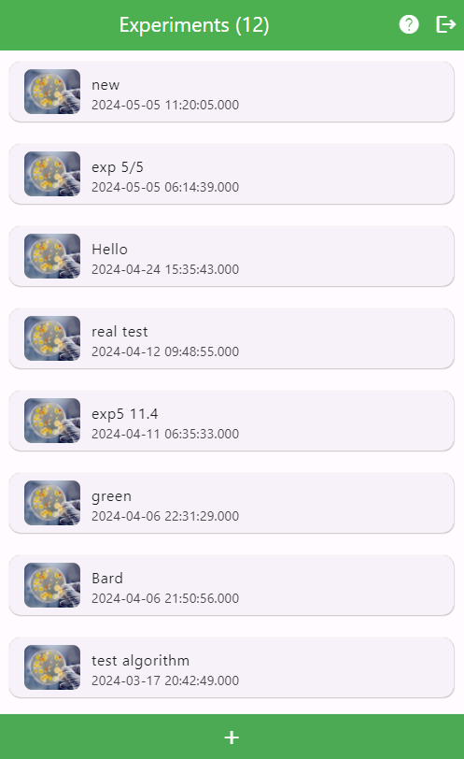
Review Experiments
View all experiments in one place.
All data is stored on the cloud.

Slide 17
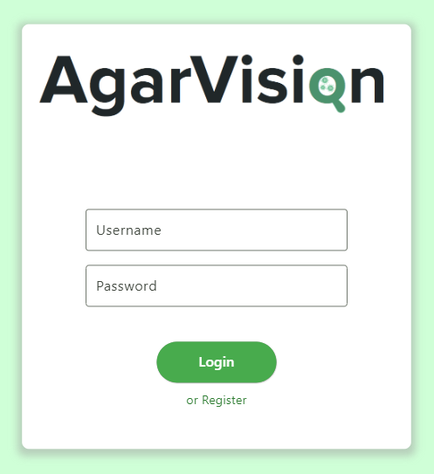

Security
Authentication & Authorization.

Slide 18


How?
Tailored Image-Processing algorithm

Slide 19
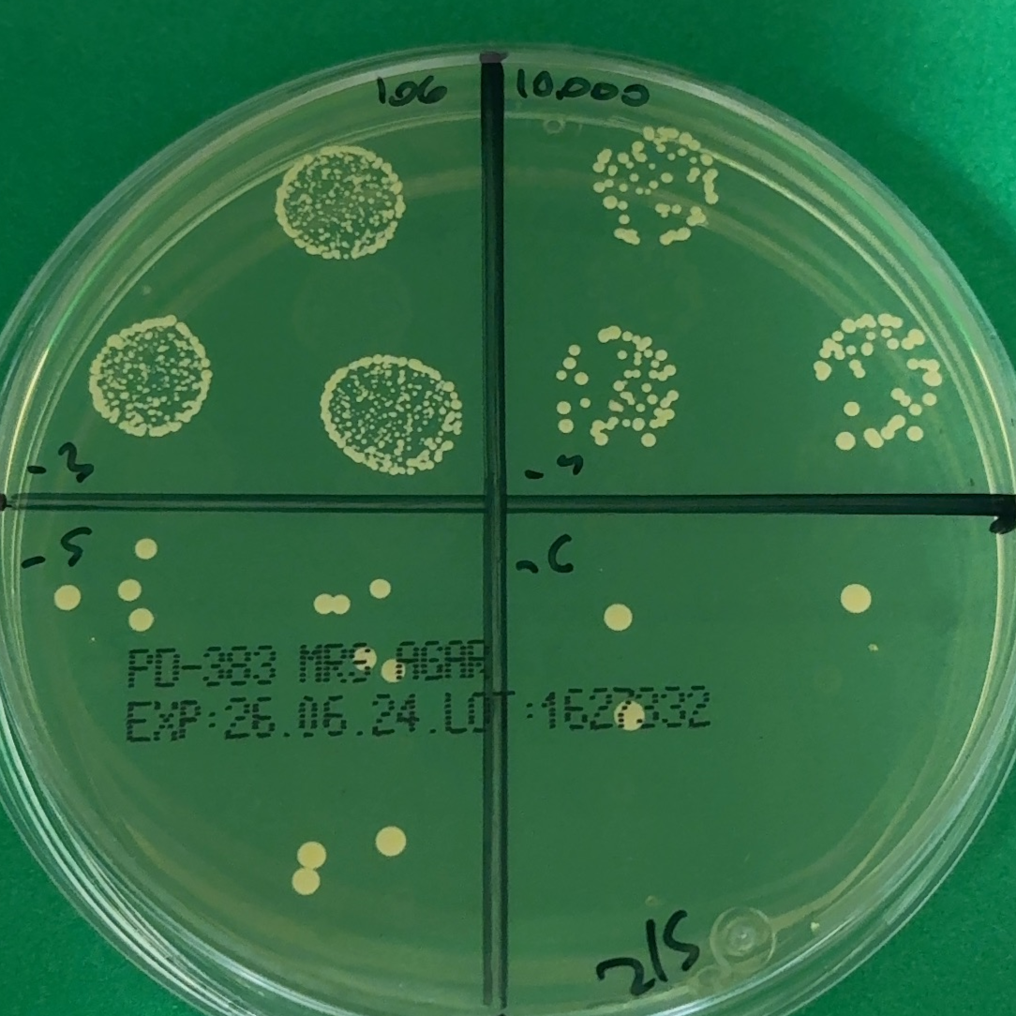
Algorithm Steps
Noise Reduction
Image Division
Image Masking
Contour Detection
K-Means Clustering
Notes:
Adaptive Thresholding: Dynamically adjust image contrast to enhance the visibility of colonies against the agar background.
Noise Reduction: Apply Gaussian blur to smooth the image, reducing noise and irrelevant details.
Image Masking: Use binary masks to isolate regions of interest, focusing analysis on bacterial colonies.

Slide 20
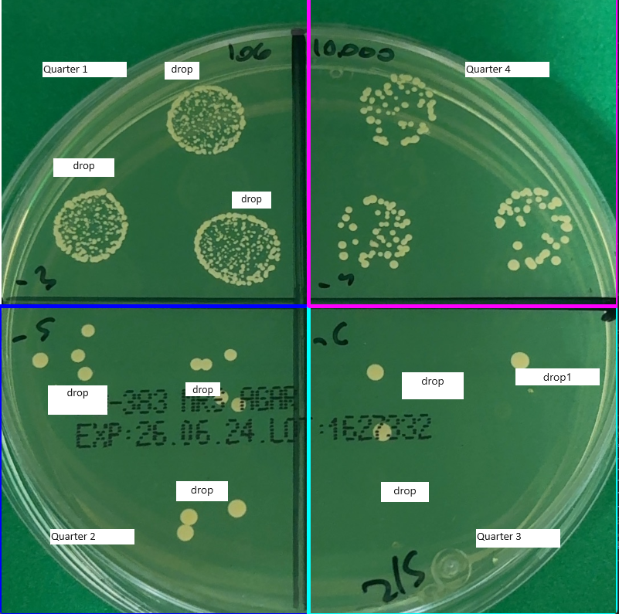
Algorithm Steps - Image Division
Notes:
Adaptive Thresholding: Dynamically adjust image contrast to enhance the visibility of colonies against the agar background.
Noise Reduction: Apply Gaussian blur to smooth the image, reducing noise and irrelevant details.
Image Masking: Use binary masks to isolate regions of interest, focusing analysis on bacterial colonies.

Slide 21
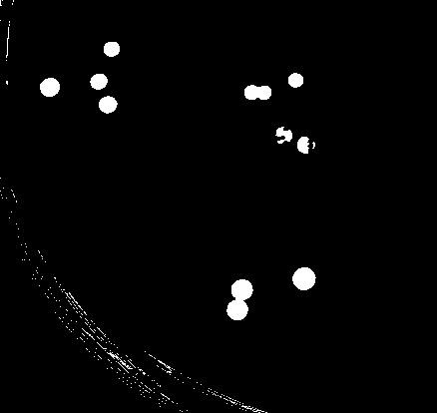
Algorithm Steps - Masking
Notes:
Adaptive Thresholding: Dynamically adjust image contrast to enhance the visibility of colonies against the agar background.
Noise Reduction: Apply Gaussian blur to smooth the image, reducing noise and irrelevant details.
Image Masking: Use binary masks to isolate regions of interest, focusing analysis on bacterial colonies.

Slide 22
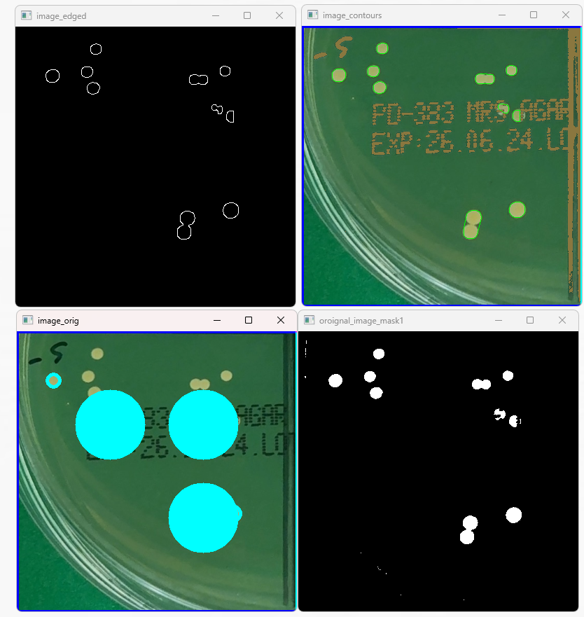
Algorithm Parts - Colony Detection
2. Contour Detection
4. Detected
3. K-means Clustering
1. Masking
Notes:
Edge Detection: Utilize the Canny edge detector to identify potential colony boundaries.
Contour Detection: Extract contours from the edged image using OpenCV findContours method.
K-Means Clustering: Apply clustering on spatial data of contours to differentiate overlapping colonies.

Slide 23
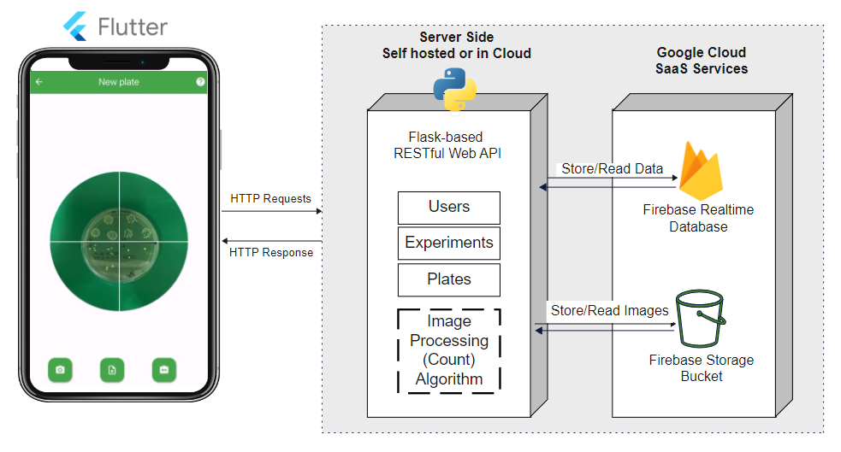



System Architecture
Notes:
As ibrahim mentioned, we will have a mobile app, which will be developed using flutter.
And by TCP/IP and HTTP request we will make the request to the service-side that will be divided into two main modules, the restful web api and the ML module.

Slide 24

All Goals Achieved!
User Friendly Mobile App
Store & Manage Experiments Data Easily and Securely
Accurate & Fast bacteria colony count

Slide 25
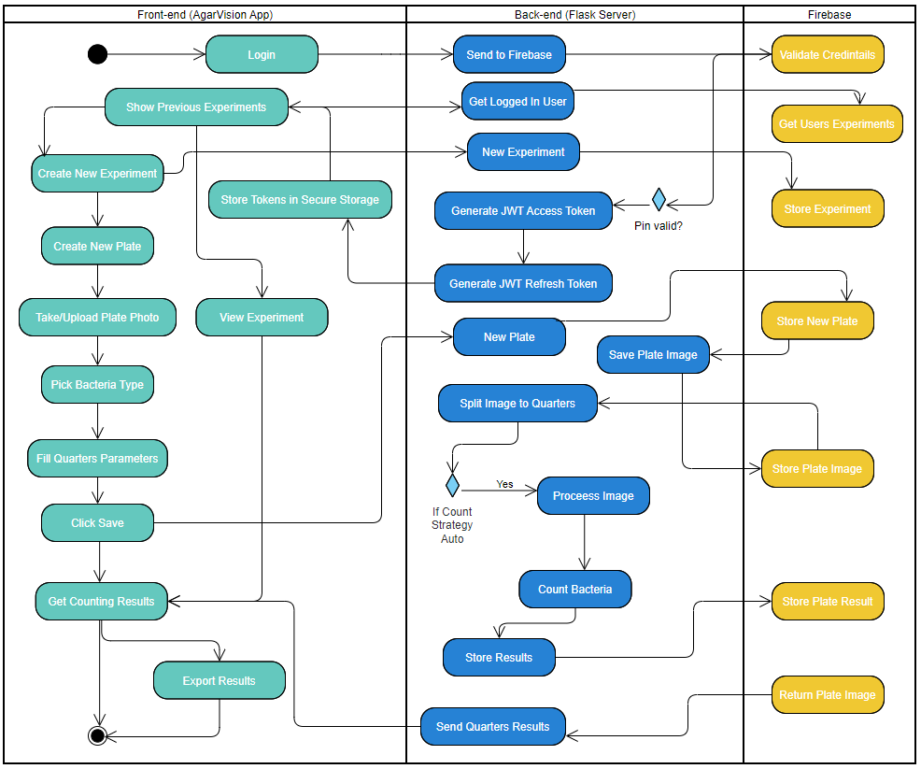
Activity
Diagram

Slide 26
Challenges

Slide 27
Challenges & Limitations
Complex Image-Processing Algorithm
Complex Colony Forms
Insufficient Data Sets
In the R&D Process

Slide 28
Challenge 1 Complex Image-Processing Algorithm
Masking & Color Detection isn’t enough
Contour Detection isn’t enough - Chat GPT sol.
Circle Hough Transform isn’t enough - our MVP
We Pivoted to a New Hybrid Image-Processing Algorithm.

Slide 29
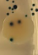
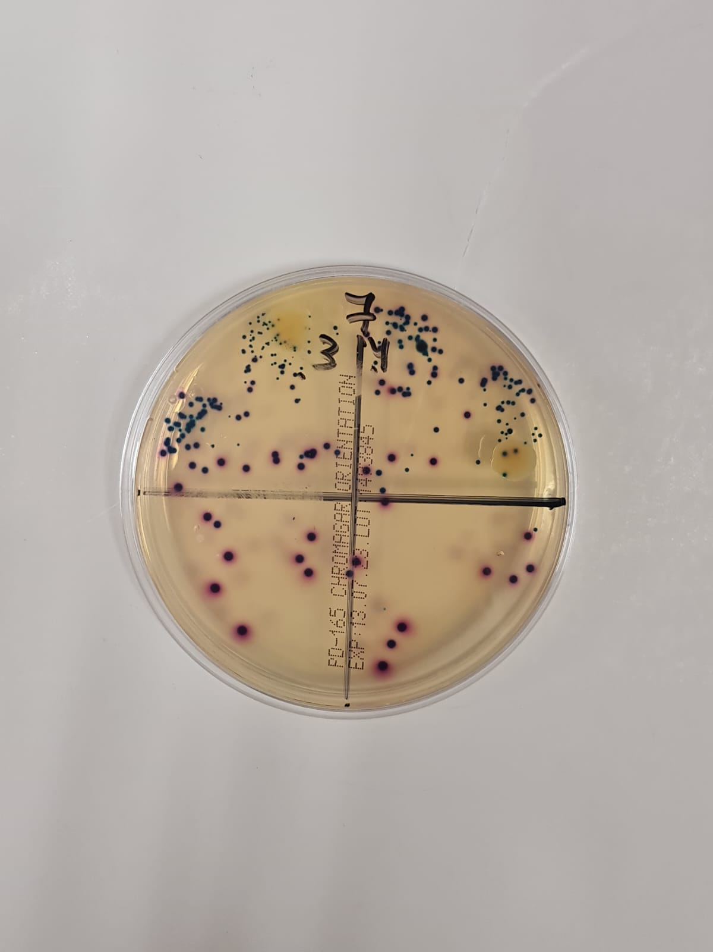
Challenge 2 Complex Colony Forms
Crowded colonies
Competitive bacteria
Text on plate
External noise
1
2
4
3

Slide 30

Challenge 3 Insufficient Data
Not Enough Chrome Plate Samples
We Pivoted to a New Image-Processing Algorithm.

Slide 31
Results

Slide 32
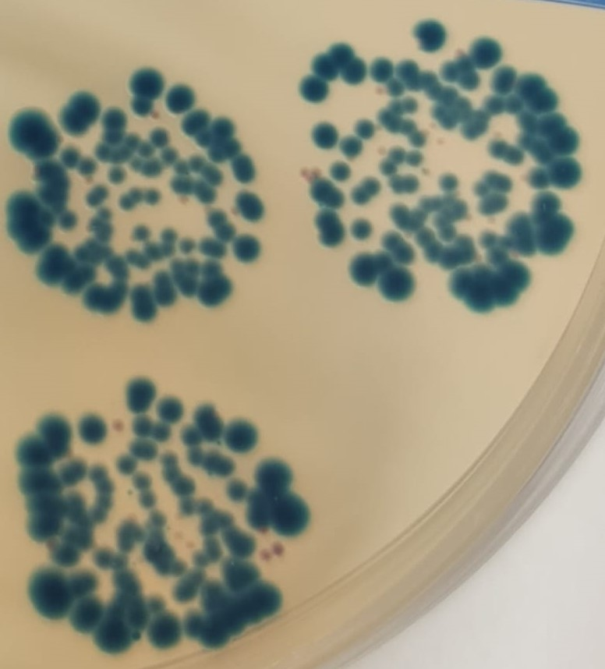
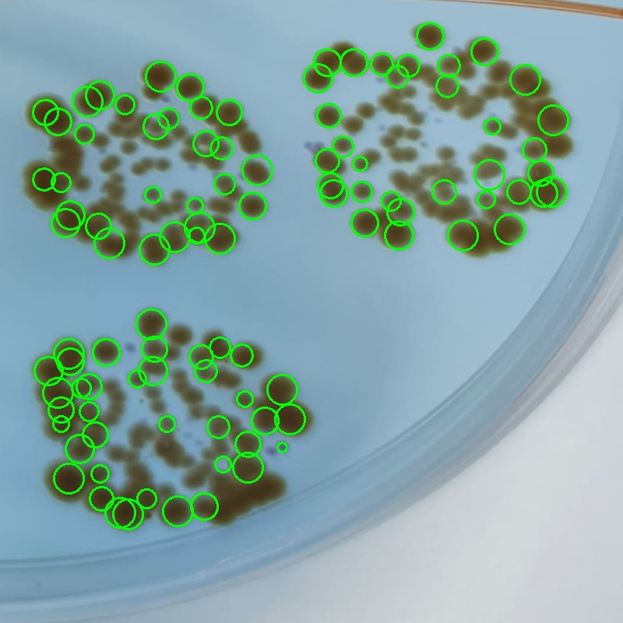
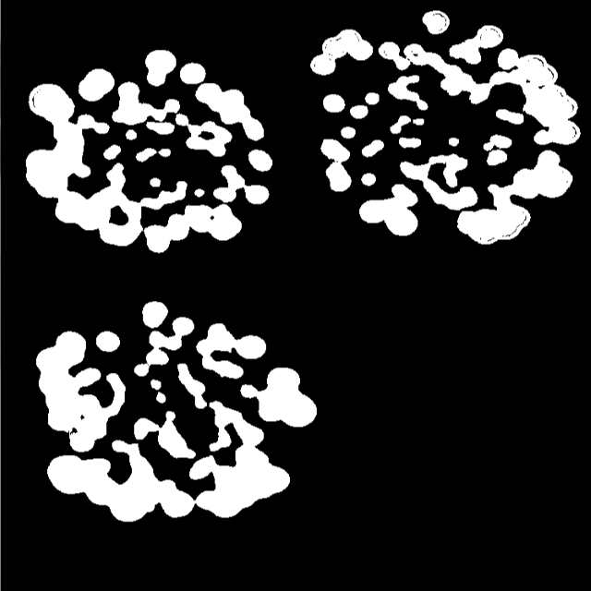
Sample 1
110 Bacteria Colonies Detected.
Notes:
Here we can see a successful test of our MVP or prototype algorithm. with medium to high accuracy.
As you can see, the algorithm draws circles in each colony detected successfully.

Slide 33
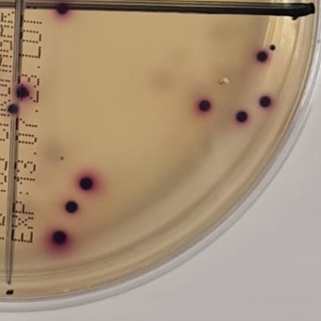
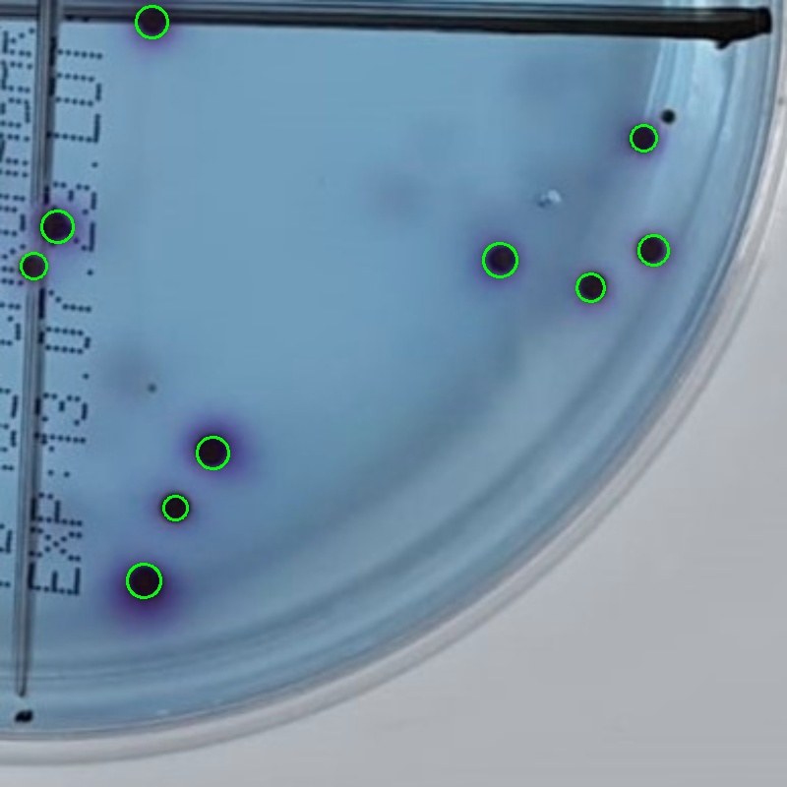
Sample 2
10 Bacteria Colonies Detected.
Notes:
The second sample was without crowded colonies. But with different bacteria shapes.
As you can see, the algorithms successfully detected the same types of colonies, and the different one here, did not.

Slide 34
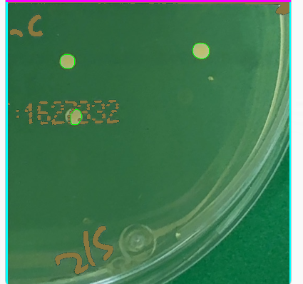
Sample 3
12 Bacteria Colonies Detected.
3 Bacteria Colonies Detected.
Notes:
The second sample was without crowded colonies. But with different bacteria shapes.
As you can see, the algorithms successfully detected the same types of colonies, and the different one here, did not.

Slide 35
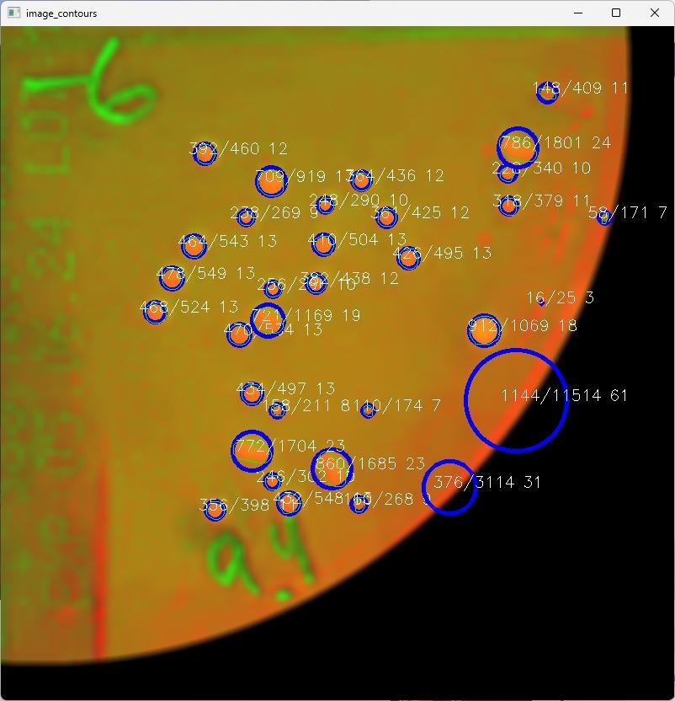
Sample 4
35 Bacteria Colonies Detected.
Notes:
The second sample was without crowded colonies. But with different bacteria shapes.
As you can see, the algorithms successfully detected the same types of colonies, and the different one here, did not.

Slide 36
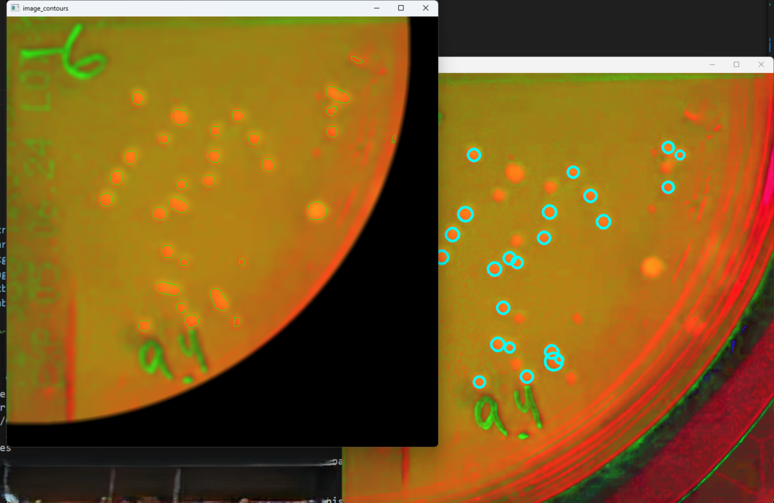
Sample 5
23 Bacteria Colonies Detected.
Notes:
The second sample was without crowded colonies. But with different bacteria shapes.
As you can see, the algorithms successfully detected the same types of colonies, and the different one here, did not.

Slide 37
Verification

Slide 38
Verification
Step 1
Step 2
Step 3
Step 4
Get a labeled image from scientists
Run Counting Algorithm
Check for true-positive, false-positive bacteria types
Check for true-negative, false-negative bacteria types

Slide 39
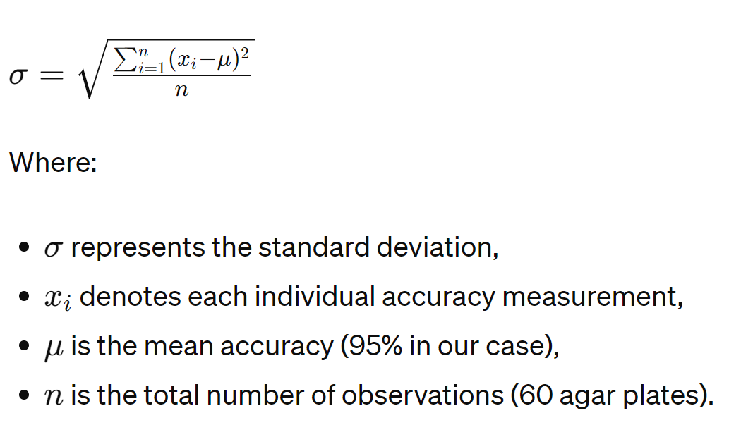
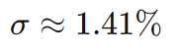
Accuracy Analysis

Slide 40
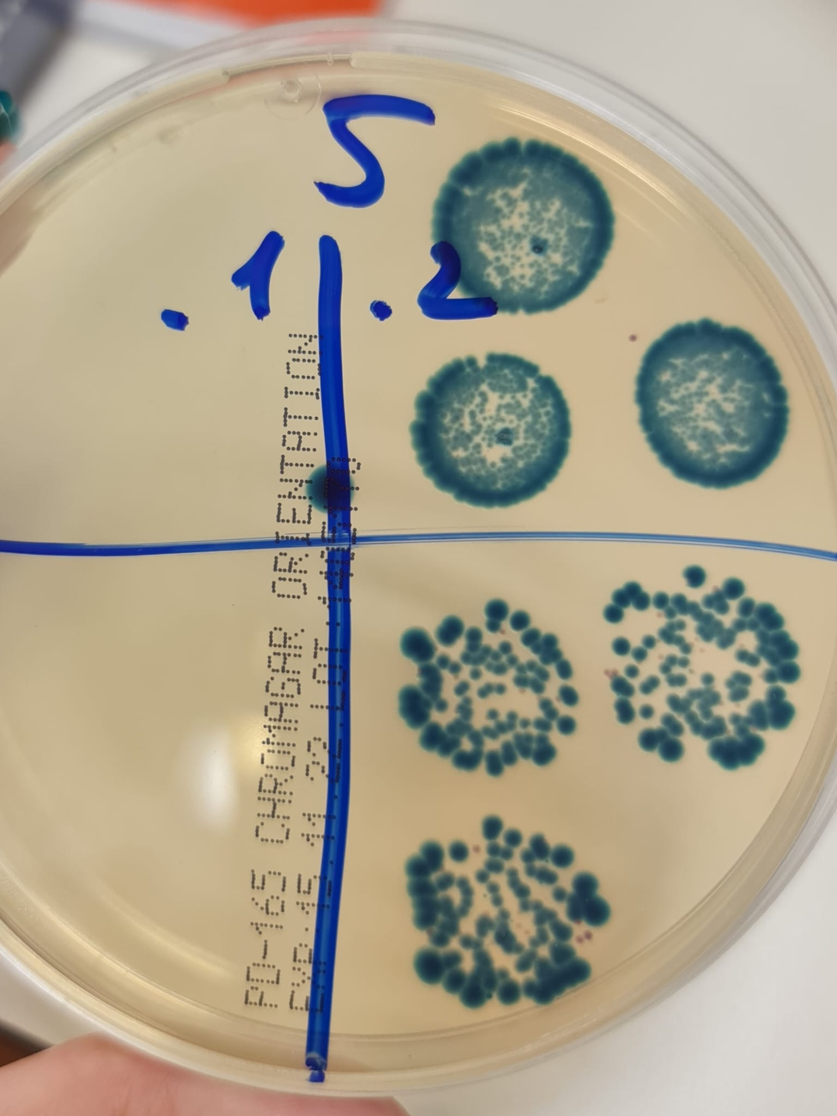
Counting Process Verification
# | Test ID | Description | Excepted Result
1 | Input: | Divide the agar plate to 4 quarters | 4 quarters.
2 | Input: | Count probiotics bacteria. | ~110 colonies. Not recognized bacteria.

Slide 41
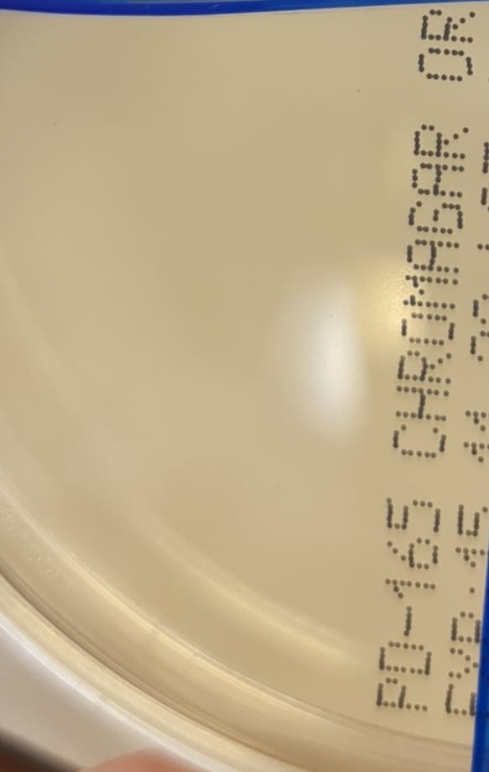
Counting Process Verification (Cont.)
# | Test ID | Description | Excepted Result
3 | Input: | Count the quarter. | 0 colonies.
4 | Input: | Count the quarter | 10 colonies. Bacteria B. 1 colony.Bacteria: Not recognized.

Slide 42

Demo - Check it out !

Slide 43

Conclusion
We aim to save scientist a lot of Time & Money.
Allowing them to advance their research faster.

Slide 44

THANK YOU

